Slide 1
DEPARTMENT OF MECHATRONICS
2019 – 2023
MRD 415 - PROJECT PHASE 1
GUIDED BY :
Ms. SHAMIN
ELIZABETH VARKEY
TEAM MEMBERS :
ALBIN DAVID C
JOEL VARGHESE
SAJAN T JOHN

Slide 2
THE WALL PAINTING ROBOT

Slide 3
CONTENTS
INTRODUCTION
OBJECTIVES
LITERATURE REVIEW
METHODOLOGY
CONCLUSION
REFERENCES

Slide 4
INTRODUCTION
A wall climbing robot is a robot with the capability of climbing vertical surfaces.
The targeted capability to stick with surface can be achieved by duct fan.
We are required to ensure safety of the painters and all crew members needs to be considered.
The robot has to identify the objects on the wall.

Slide 5
OBJECTIVES
Develop a modular, re-configurable, wall-climbing robotic system and to investigate intelligent control methods and vision algorithms to control and coordinate a team of such robots to perform various function

Slide 6
SUB OBJECTIVES
Simple Design for the robotic platform.
Circuit design with limited components.
Vacuum production for climbing.
Identifying the doors and windows by image processing or machine learning.

Slide 7
METHODOLOGY
DC Motor
Duct Fan
Controller
Chassis
Camera
Arduino
Electrical wires & Tubes
Power Supply

Slide 8
METHODOLOGY
Duct fan is used to provide suction effect between the robot and wall
DC motors are used to drive the robot
The chassis is made up of acrylate material
A wireless webcam used to detect the obstacles while moving.
A power supply is provided through wired connection.

Slide 9
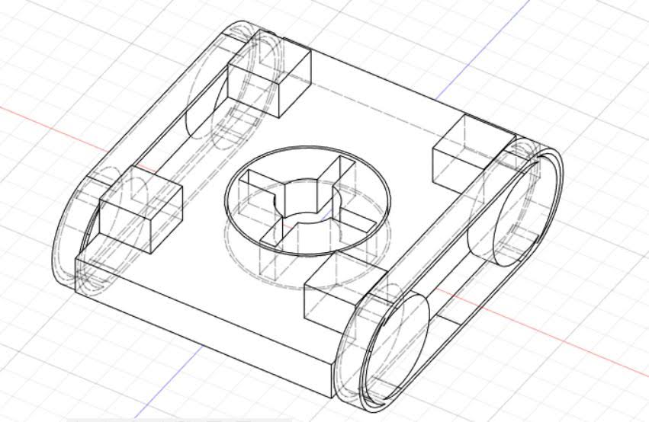
PRIMARY DESIGN

Slide 10
LITERATURE REVIEW
A Novel Mechanism Design Technique To Develop A Vertical Climbing Robot With High Mobility For Flat And Spherical Surfaces [1].
The robot is especially designed to climb any vertical surfaces with the help of reverse propulsion technology.
The robot is build keeping overall body weight at minimum.
The robot can be used for operations such as
Surveillance
Inspection
Cleaning

Slide 11
LITERATURE REVIEW
Duct fan based wall climbing robot for concrete surface crack inspection [2].
An efficient and low cost wall climbing robot.
The thrust force provided by the duct fan holds the robot on the wall.
This robot is like a four wheeled vehicle on the wall surface.
It captures the image under the inspection using a camera mounted on it.
The taken images are processed using the image processing.

Slide 12
CONCLUSION
We are planning to design our own unique wall-climbing robot with mechanisms for suction, rotation and turning. We intend to implement techniques for its control as well.
In future, we believe we can fabricate this efficient prototype.

Slide 13
REFERENCE
S. S. Khan, A. R. Akash, S. Maaj, M. R. Hassan and M. A. Rahman, "A Novel Mechanism Design Technique To Develop A Vertical Climbing Robot With High Mobility For Flat And Spherical Surfaces," 2021 2nd International Conference on Robotics, Electrical and Signal Processing Techniques (ICREST), 2021, pp. 303-307, doi: 10.1109/ICREST51555.2021.9331113.
P. Sekhar and R. S. Bhooshan, "Duct fan based wall climbing robot for concrete surface crack inspection," 2014 Annual IEEE India Conference (INDICON), 2014, pp. 1-6, doi: 10.1109/INDICON.2014.7030589..

Slide 14
THANKS
Have a nice day.

